Slide 1
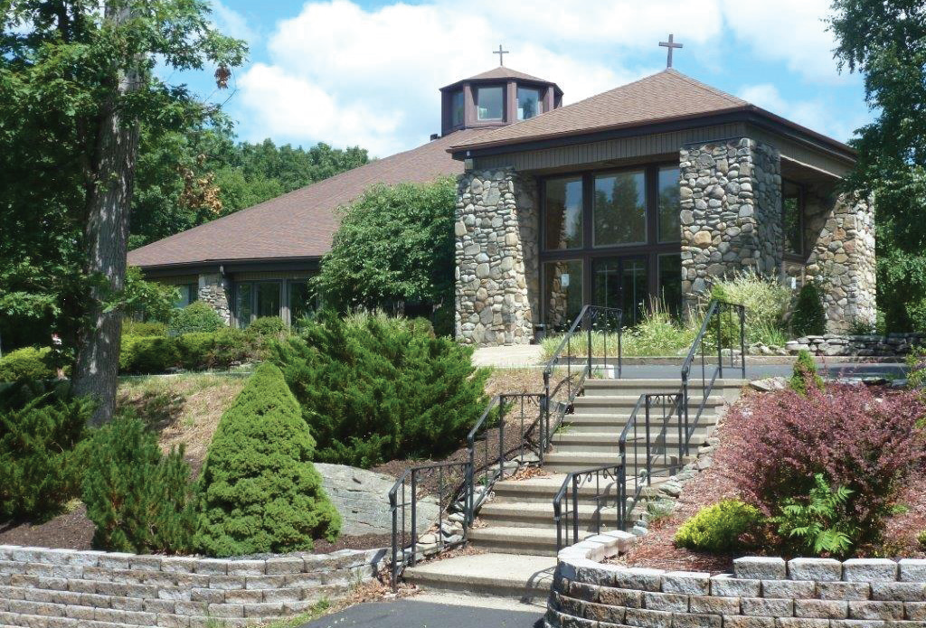
St. Vincent de Paul Church Faithful Stewards Implementation Plan

Slide 2
Stewardship Committee
From “Generous Hearts” to “Faithful Stewards”
Stewardship management
Common language
Annual commitment in June
Calendar
Notes:
Stewardship Committee: We had a stewardship ministry, Generous Hearts, in place for 5 years which has now been renamed Faithful Stewards. The team currently has eight members. Some from the old GH team and some new members.
This team will coordinate with Father John, our pastor, all aspects of the parish stewardship plan to ensure a stewardship theme and common language is incorporated into everything we do. A year long plan for establishing and sustaining stewardship in the parish will be incorporated into our best practices.
We have, in the past, used a version of an annual commitment and we will continue to do it the beginning of June. This annual commitment includes time, talent and treasure. We plan to continue this and the newly formed Faithful Stewards ministry will coordinate pulpit talks, bulletin announcements, etc.
The new Faithful Stewards ministry will develop an annual plan with seasonal focus points based on the many available options.

Slide 3
Pastoral Support
Pastor support
Pilot Participation
Sunday Liturgy
Prayers of the Faithful
Bulletin
Pastor’s Corner
Announcements
Ministry Leadership
Notes:
Sunday Liturgy - Father John will mention stewardship themes in his homilies where appropriate. The Deacons will also be asked to incorporate it into their monthly homilies. A stewardship prayer, from the OPL 2019 calendar, will be seasonally incorporated into the mass similar to how the Arise prayer was used. Stewardship will be added to the Prayers of the Faithful.
Bulletin - Father John has begun incorporating stewardship themes in his Pastor’s Corner for several months now and he will continue that. A scripture relative to stewardship with a question to think about will be added into the weekly bulletin. A children’s crossword puzzle, word game or other activity with a stewardship theme will be added to the weekly bulletin. Bulletin inserts with a focus on stewardship will be done at seasonal focus points.
Ministries - All 36 ministry teams will open and close all of their meetings with a stewardship prayer taken from the 2019 OPL calendar. Every ministry member needs to hear the same stewardship message. Prayers will be changed based on the seasonal focus points.

Slide 4
Parish Council and Finance Council
Active Involvement
Ongoing Pastoral Planning
Notes:
The Parish Council has been actively involved in the pilot process and fully supports our endeavors. The Finance Council has been equally involved….they need to know what the plan is so they can provide the financial support needed.
Since this is a continuous process it will require ongoing pastoral planning to make sure we reach our goal of creating a culture of stewardship in our parish.
Working together we can make it happen.

Slide 5
Publicity
Newsletter
Website
Email/Postal Mail/Remind/Facebook
Lay Witness
Signage
Notes:
Newsletter – A quarterly, seasonal newsletter, more in-depth than the bulletin will be published and will include a financial report. This will include something like “Faces of St. Vincent’s” to highlight parishioners.
Website – A Stewardship block will be added and will include articles, newsletters, videos, etc. on stewardship.
Email/Postal Mail/Remind/Facebook – Stewardship material provided for the website will also appear on Facebook. Newsletters will be sent via Email and postal mail. Remind is a text messaging service currently in use to notify parishioners about upcoming events. It will be used to notify people that new material is on the website. We will also look into using Instagram and other social media apps to spread our stewardship message.
Lay Witness – Testimonials and video presentation (3 minutes) will be developed and used in the bulletin, newsletter and videos will be played on a continuous loop at the K of C Food for Families events, at the Lenten Station Suppers, etc. In person testimonies will also be used during the annual commitment weekend.
Signage - In the past we have posted banners for various programs in the Narthex and in the rear of the church. We will continue this during the seasonal focus times with a stewardship theme.

Slide 6
Faith Formation
Adults
Teens
Children
Notes:
Faith Formation – Adults – We currently have a “Share the Sunday Readings” group in the evenings. Father John plans to start a bible study group in the near future. RCIA will be a topic for the Newsletter. Be My Witness will be starting in February for small groups. Retreats will continue to be offered. Parent led service projects -Linking parents with their children for community events will be considered….i.e. a team of parents to sponsor an event in their community, raking leaves for the aged, washing windows, Salvation Army truck pick up point, etc. would foster stewardship in the family.
Faith Formation – Teens – We currently have a Youth Group but the number of active teens is dwindling. A Youth Group recruitment drive with a stewardship theme will be considered. Development of a peer ministry will also be considered.
Faith Formation – Children – We currently have a Children’s Liturgy ministry and it will incorporate a way for children to become stewards. The stewardship message will be incorporated into the weekly material presented. An envelope program will also be considered specifically for the children. A canned food collection for the Food Pantry may also be appropriate for this age group.
All children, Youth Group, Faith Formation, Children’s Liturgy, will be referred to as “Young Disciples” as often as possible.

Slide 7
Ministries
Word, Worship, Community and Service
Music Ministry
Notes:
To allow all parishioners to participate in stewardship ministries, we will add an Assorted Ministry group to focus on the talents of parishioners who may not be able to join a formal ministry that requires a reoccurring time commitment but would like to contribute their talents on an “as needed” basis. (I.e. someone good at photography may be called upon to take pictures at events or of parishioners for the newsletter, or someone with graphic arts talent to design banners/signage, etc.)
The Music Ministry will be asked to review music selections that may lean toward stewardship (i.e. Here I Am Lord, etc.) and incorporate those during the annual commitment time period and other seasonal focus times.

Slide 8
Implementation
Phased approach
Completed/Ongoing
Pastoral Plan Goal
Stewardship Committee established
Introduction to parishioners and monthly bulletin articles
Pastor’s Corner and homilies
Currently planned
Stewardship Committee meetings
Website and other social media updates
Introduction to Ministries
Future
Lay Witness testimonials
Newsletter and signage
Annual commitment
Notes:
Building a culture of stewardship is a lifelong commitment and it will take time to fully implement all the various aspects. We believe that we have a good start and we’ll work to remain accountable for all of God’s gifts and resources.

Slide 9
On behalf of St. Vincent’s Parish Staff, Parish Council, Finance Council and all of us on the Integration Team, a big thank you to each and every one of you for your guidance, support and most of all, sharing your knowledge.
Together we are building a culture of stewardship!

